Slide 1



Journey to Spaceport
Charlie Nitschelm
Prospective SpaceX Employee, Build Engineer
University of New Hampshire
Students for the Exploration and Development of Space

Slide 2
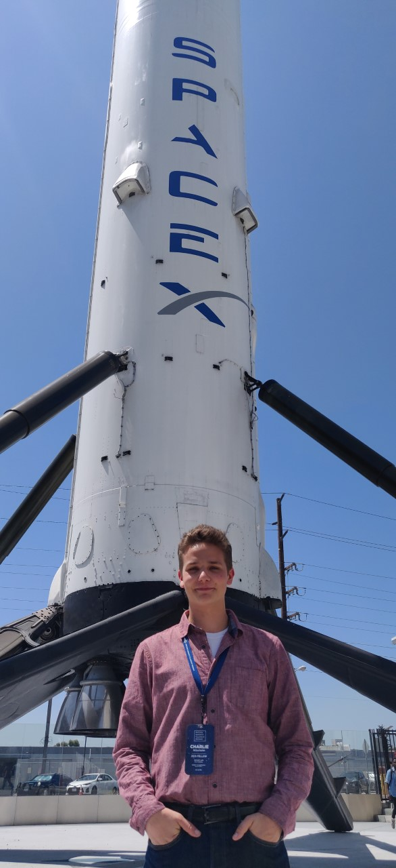
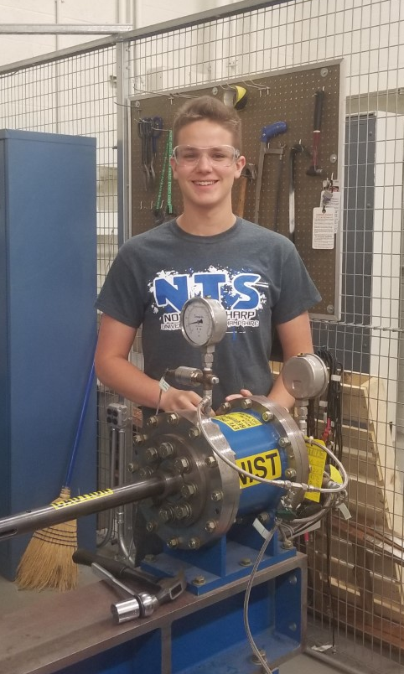
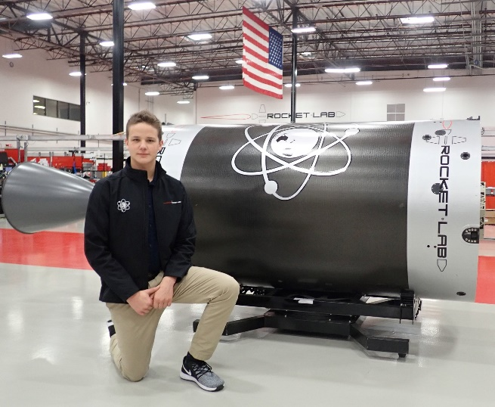
My Background
Just visiting!
Senior mechanical engineering major and physics minor at the University of New Hampshire
Founded UNH SEDS and the current President and Lead Engineer
Member at Large at SEDS USA
Job Experiences ___
Summer 2018
Inconel Behavior at NIST ___
2018-2019 School Year
Effect of tool coatings at TURBOCAM International ___
Summer 2019
Rutherford engine production at Rocket Lab USA
University of New Hampshire
Students for the Exploration and Development of Space

Slide 3
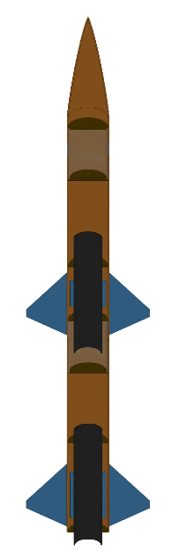



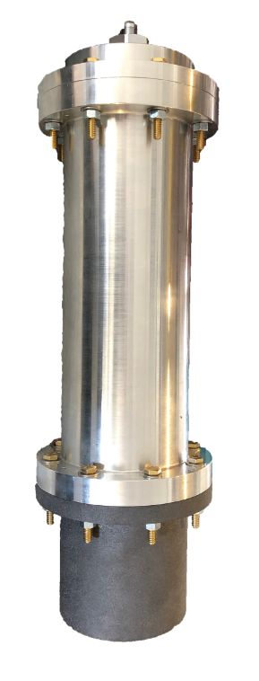
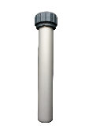
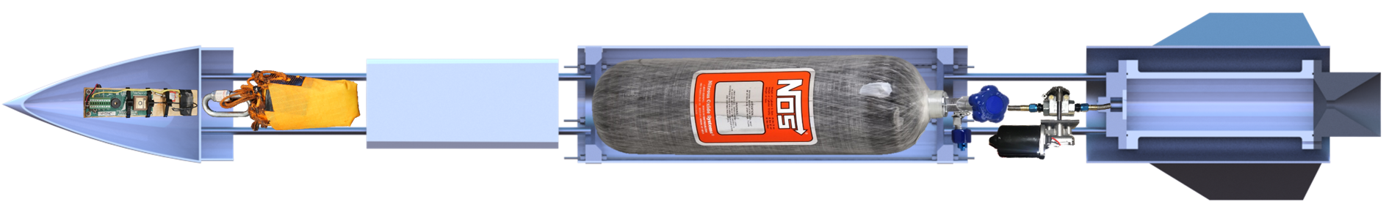

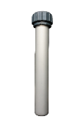
The 3-Year Plan
Year One
2017-2018
Year Two
2018-2019
Year Three
2019-2020
Runaway
Rocket Building
Simulating
Launching
Optimizing
Hybrid Engine
Engine Design
Manufacture
Test
Hybrid Rocket
Spaceport America Cup
Rocket Vehicle
Engine Optimization
University of New Hampshire
Students for the Exploration and Development of Space

Slide 4
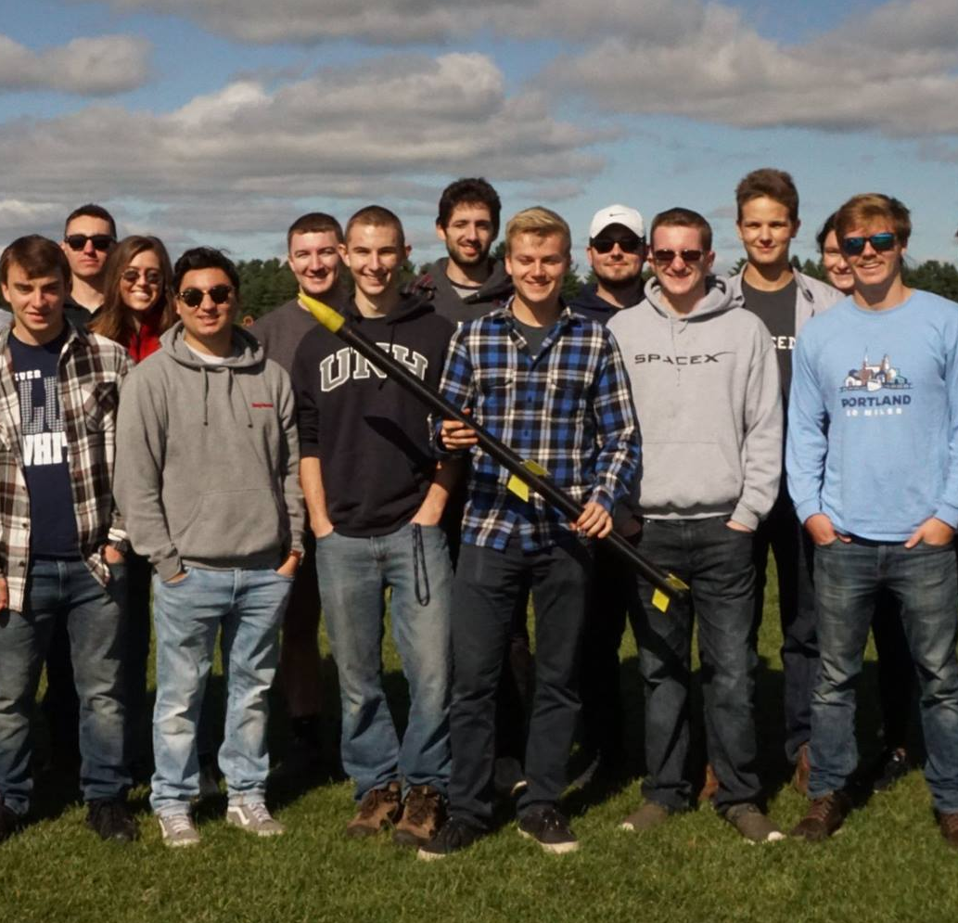
Year 1 – Sophomore Year
Organization Statistics
Committed Members: 11
Majors: 3
Senior Projects: 4
Funding: $2,250
My Role
President, Lead engineer
SEDS Rocketry Competition, May 2018, Maine
University of New Hampshire
Students for the Exploration and Development of Space

Slide 5
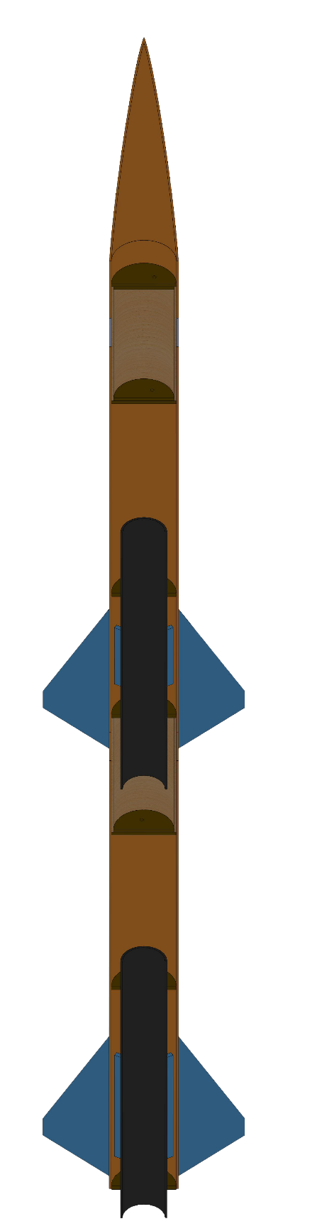
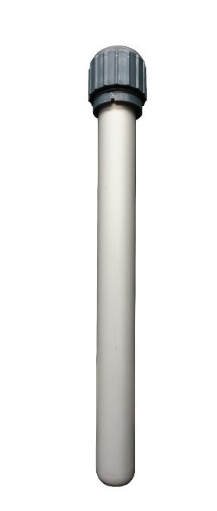

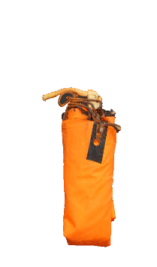
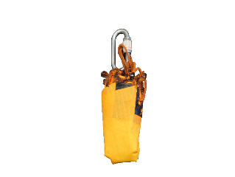
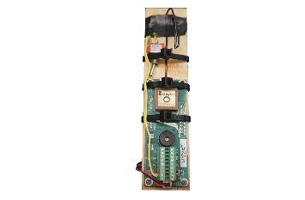

Year 1 – Rocket Building
Electronics Bay
Houses the TeleMega GPS and controls flight events
Staging Coupler
Supports stage separation at sustainer ignition
Drogue Parachute
A small parachute deployed at apogee
Forward Fins
Provides stability to
the sustainer
Aft Fins
Provides stability to the rocket
Custom Nose Cone
A 3D printed nose cone that houses the drogue parachute
Sustainer Engine
Propels the rocket to flight apogee
Booster Engine
Initiates flight
Sustainer Parachute
The main parachute that slows the sustainer to landing speed
Booster Parachute
A large parachute for booster landing
University of New Hampshire
Students for the Exploration and Development of Space

Slide 6
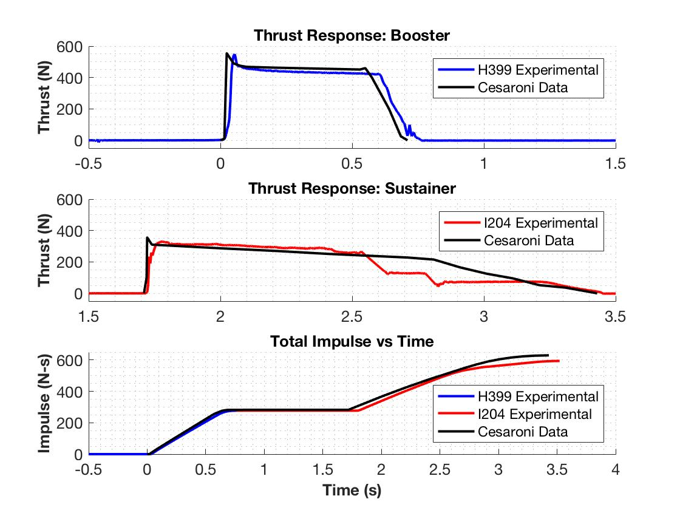
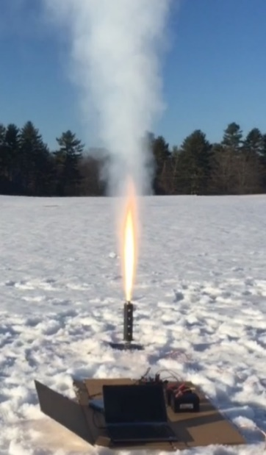
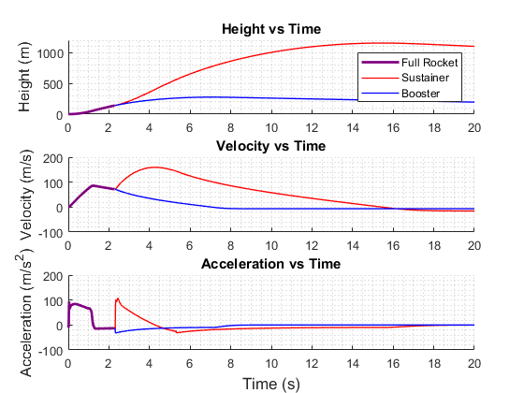


Year 1 – Simulating
$$\sum_{n=1}^{∞}{F}=\frac{d\overset{⃑}{p}}{dt}=Mass∗\overset{⃑}{a}(t,v,h)$$
$$\overset{⃑}{a}(t,v,h)=\frac{Thrust(t)−Weight(t)−Drag(t,v,h)}{Mass(t)}$$
Hot Fires of COTS engines to obtain thrust data
$Where Drag\left(t,v,h\right)={Drag}_{SF}+{Drag}_{PD}+{Drag}_{BD}$
Discrete-Event Simulation
 | Reported Max Thrust | Measured Max Thrust | Reported Total Impulse | Measured Total Impulse
Booster Engine: H399 | 545.8 N | 549.6 N | 282.2 N-s | 277.1 N-s
Sustainer Engine: I204 | 356.8 N | 329.7 N | 347.7 N-s | 322.7 N-s
University of New Hampshire
Students for the Exploration and Development of Space

Slide 7
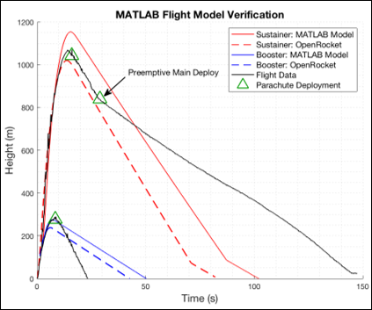
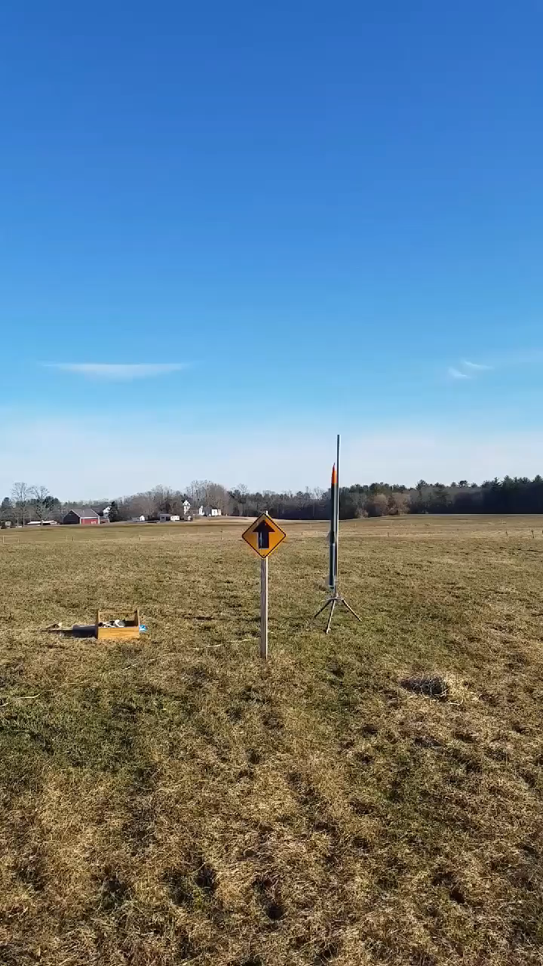
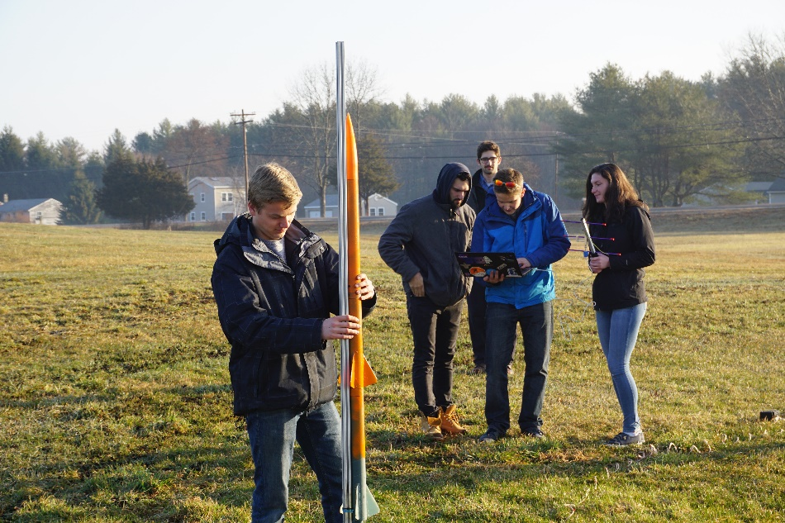
Year 1 – Launching
Built nine experimental rockets with six being multi-stage
Reduced flight failures from 4 out of the first 5 to 1 out of the last 4.
Rocket 6/9
 | Flight Data | OpenRocket Model | MATLAB Model
Sustainer Apogee | 1071.1 m | 1020.6 m | 1154.1 m
Booster Apogee | 290.0 m | 238.6 m | 276.3 m
7% Error
University of New Hampshire
Students for the Exploration and Development of Space

Slide 8
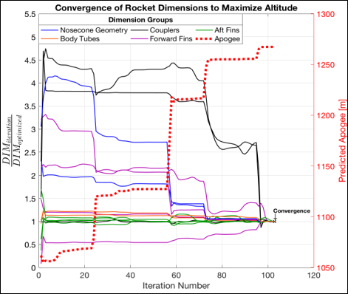
Year 1 – Optimizing and Repeat
Refined simulations to match experimental data from ± 35% on 1st rocket to ± 5 % on the last
Uses our in-house simulations in a nonlinear solver to converge on a set of rocket dimensions
Check Integrity with Finite Element Analysis
Research Aerodynamic Theory
Optimize Rocket Dimensions
Improve
Aerodynamic Models
Rocket Improvement Cycle
Manufacture and Assemble
Launch and Gather Data
Improve Manufacturing Techniques
Improve Field Launch Techniques
University of New Hampshire
Students for the Exploration and Development of Space

Slide 9
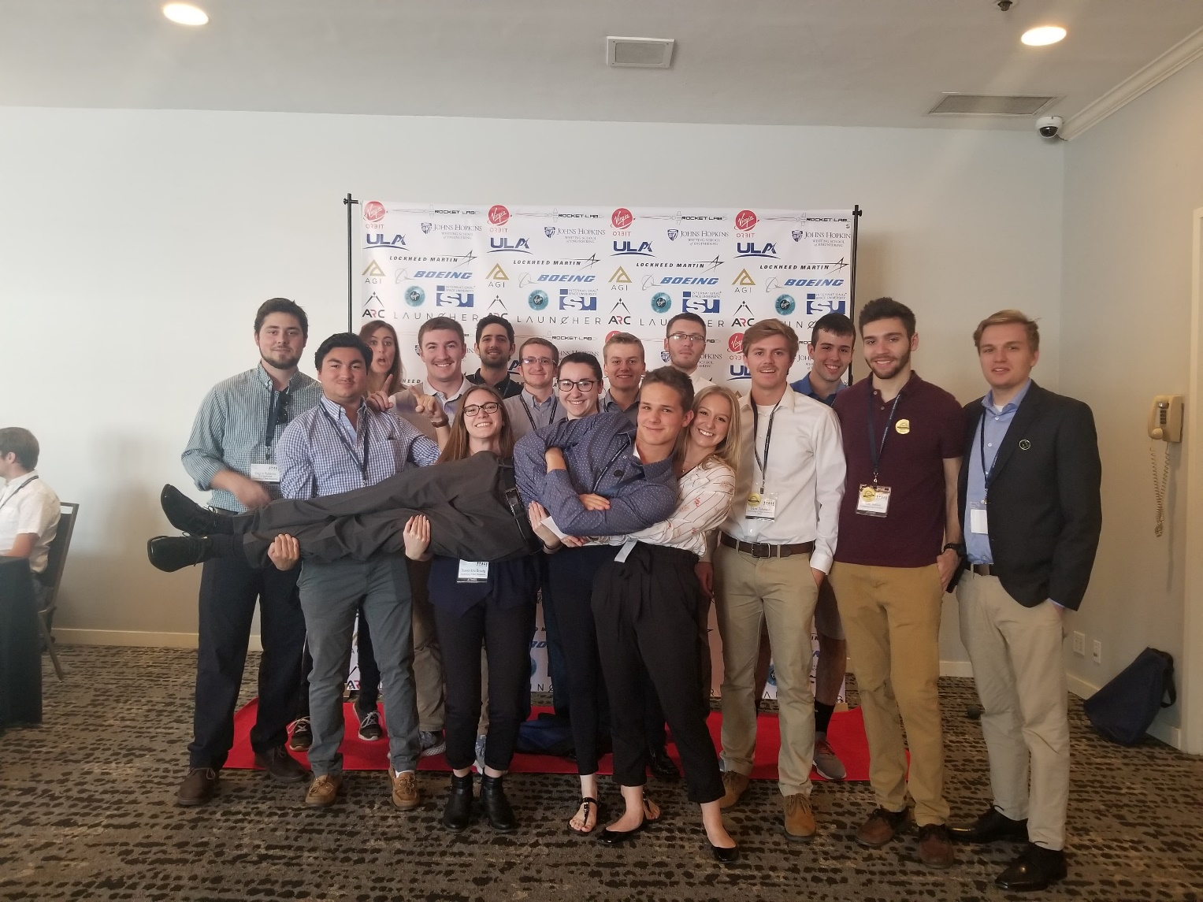
Year 2 – Junior Year
Organization Statistics
Committed Members: 20 (+9)
Majors: 5 (+2)
Senior Projects: 9 (+5)
Funding: $5,500 (+$3,250)
My Role
President, Lead Engineer
Spacevision 2018, November 2018, San Diego
University of New Hampshire
Students for the Exploration and Development of Space

Slide 10
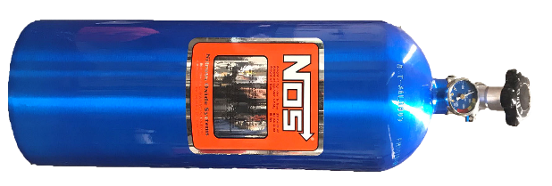
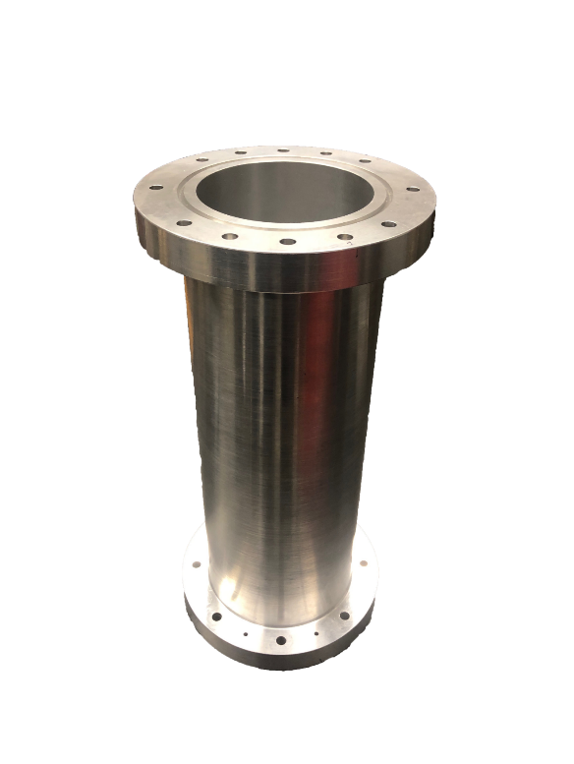
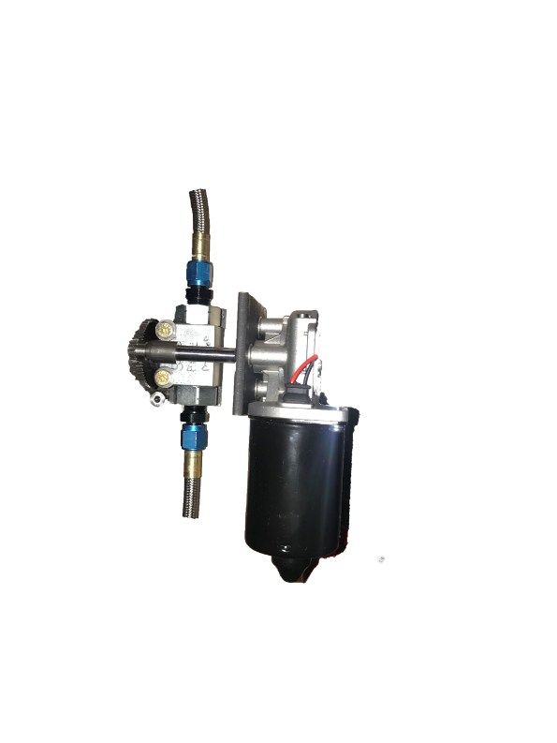
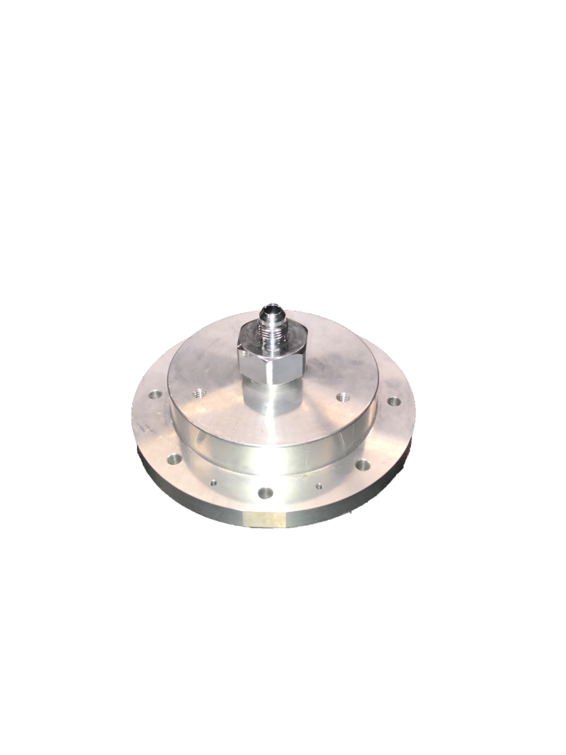
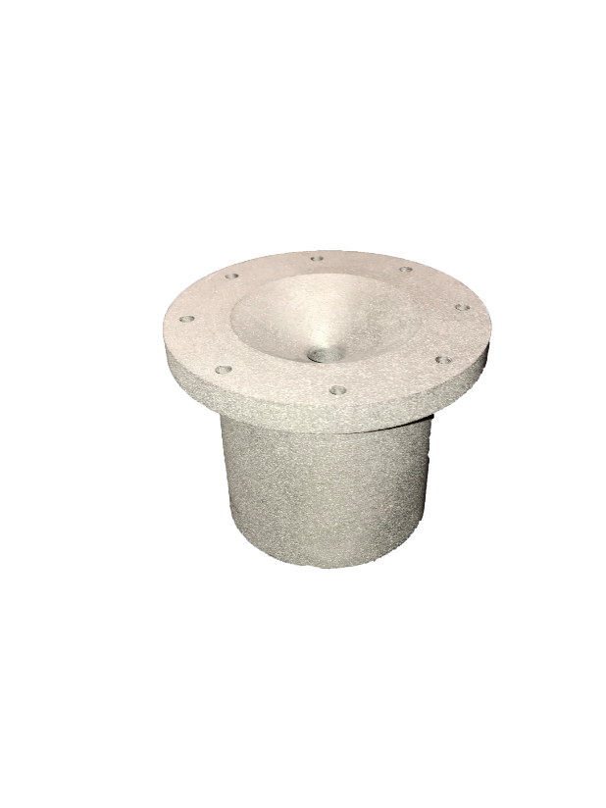
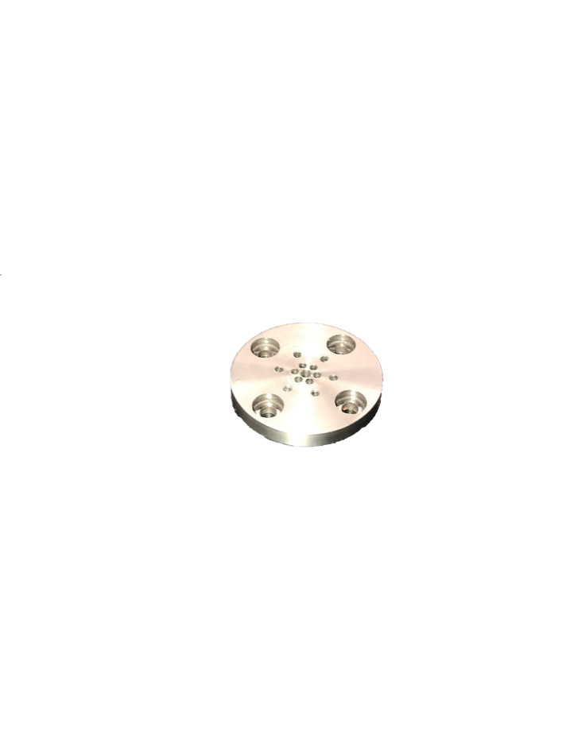

Year 2 – Hybrid Engine
Oxidizer Tank
A highly pressurized vessel that contains liquid Nitrous Oxide
Injection Plate
Responsible for providing desired oxidizer flow into the combustion chamber
Combustion Chamber
An enclosed volume that produces heated, highly pressurized gas
Flow Regulator
A motorized valve that monitors flow regulation of the liquid oxidizer
Impinging Plate
An interchangeable plate responsible for the flow streams of the oxidizer
Nozzle
Machined into a de Laval curve responsible for directing the flow of hot, pressurized gases
University of New Hampshire
Students for the Exploration and Development of Space

Slide 11
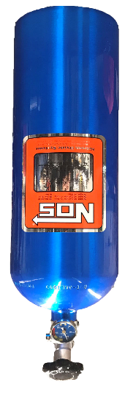
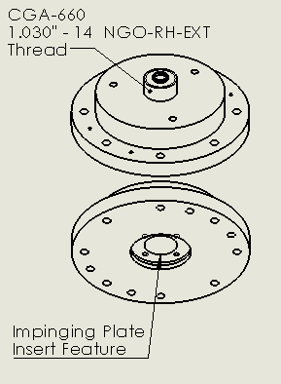
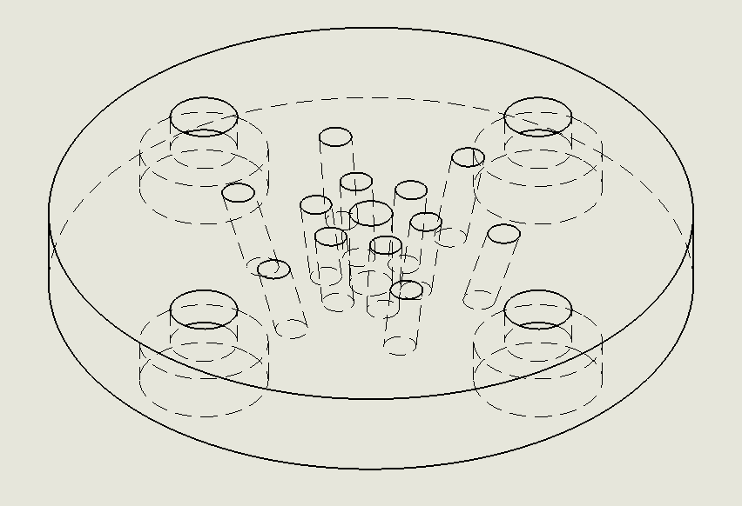
Year 2 – Engine Design
From past hybrid papers: ~400 psi and 700 K
Oxidizer Selection and Flow Regulation
Injector and Impinging Plate
Needs to be self pressurizing
Needs to be safe to handle
Can be refilled within a day
Nitrous Oxide meets these requirements
Interface with COTS piping from flow regulator
Quick testing of different impinging geometries
Transitions the liquid oxidizer to a gas
Suitable for ground testing
Ability to throttle
1000 psi rated valve/tubing
Cheap – 150 dollars
University of New Hampshire
Students for the Exploration and Development of Space

Slide 12
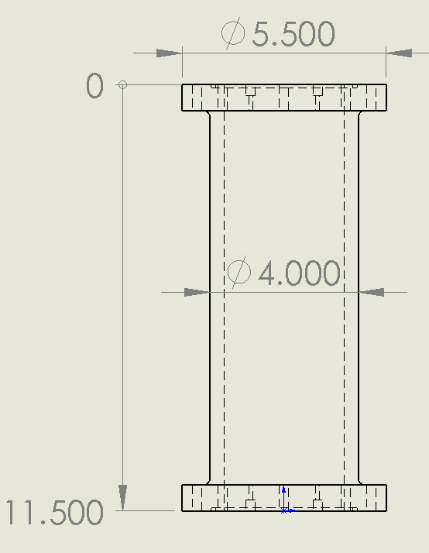
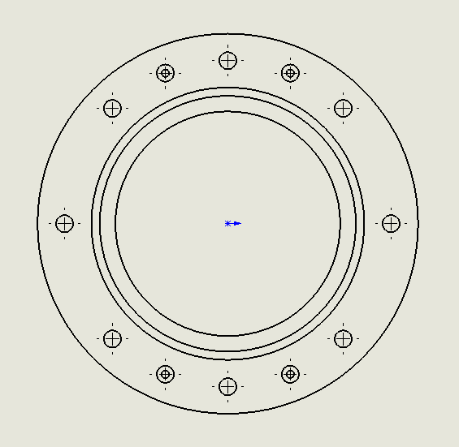
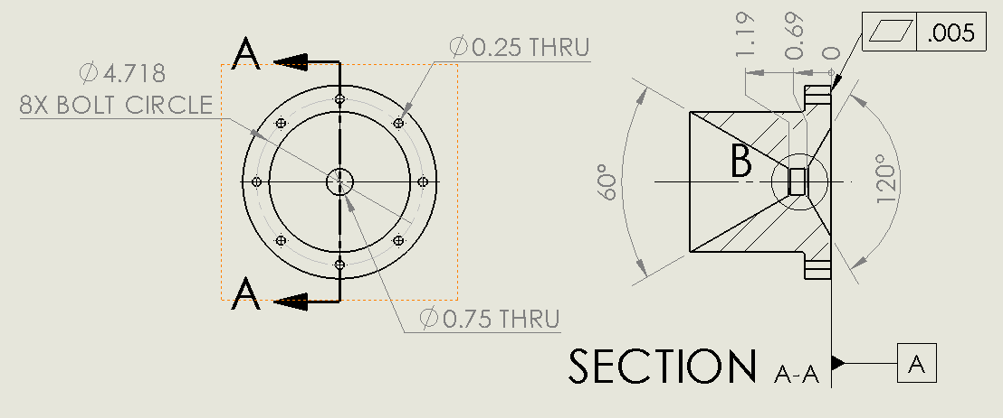
Year 2 – Engine Design
From past hybrid papers: ~400 psi and 700 K
Combustion Chamber
Nozzle
Withstand internal operating conditions
Hold a volume of fuel (HTPB) to support the defined mixture ratio (~6)
Seals with the nozzle and injector flanges
Accelerate the hot gases within the combustion chamber using converging/diverging design
Withstand a corrosive, high temperature environment
Designed these components in Solidworks, no experience with NX but understand differences (tree, solid bodies, no convert entities)
University of New Hampshire
Students for the Exploration and Development of Space

Slide 13
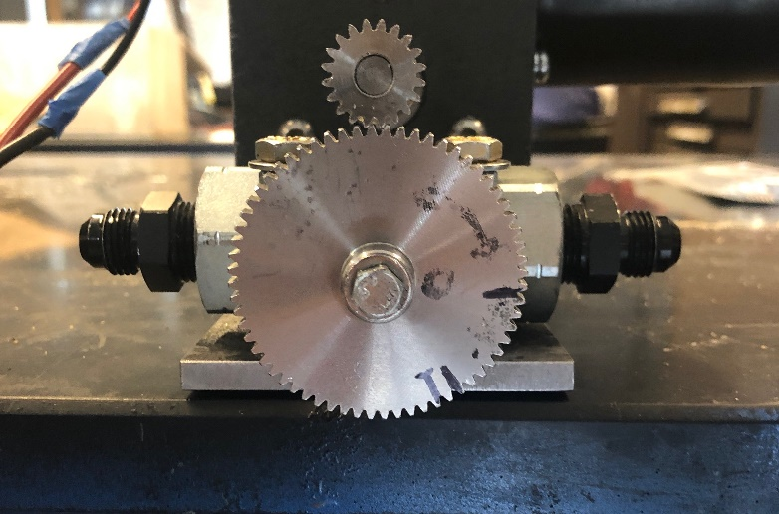
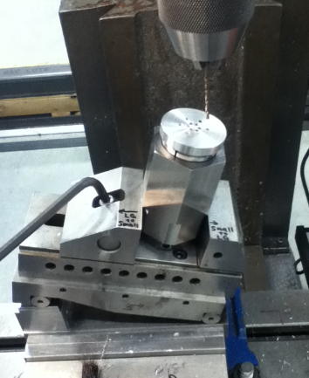
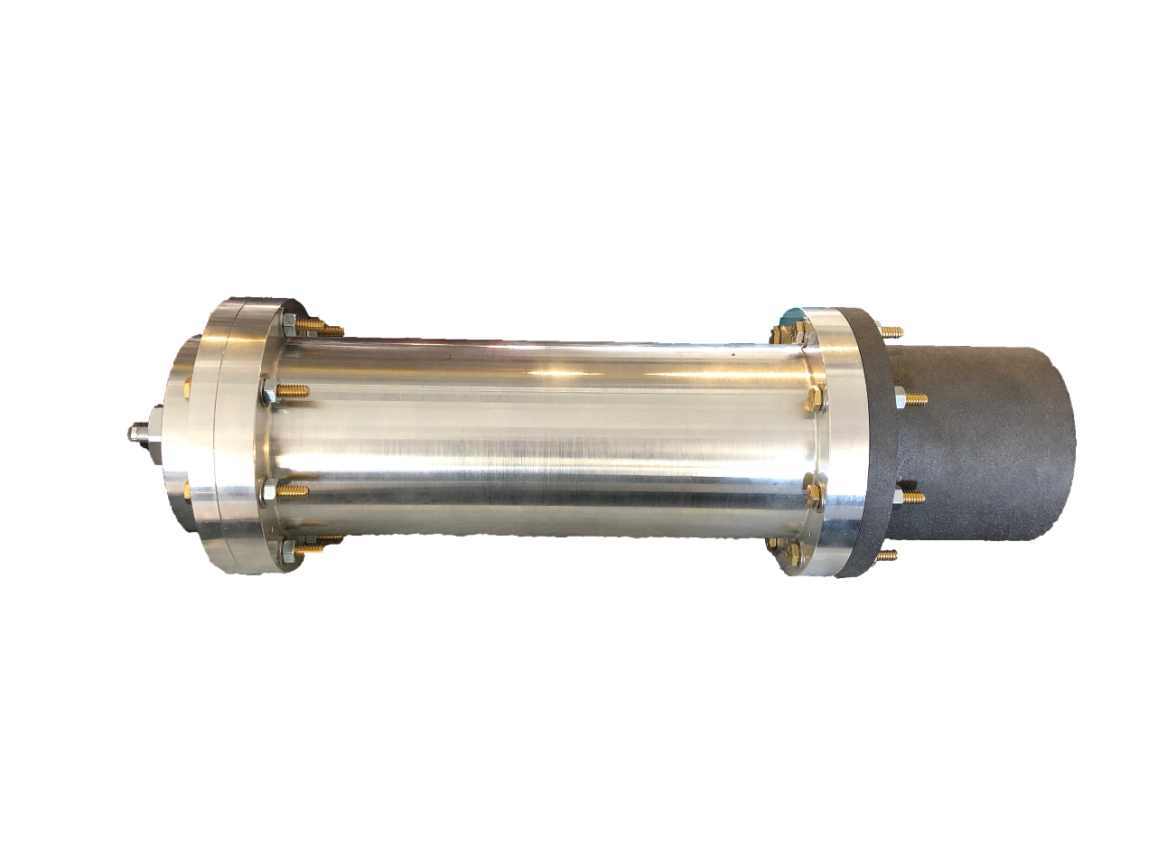
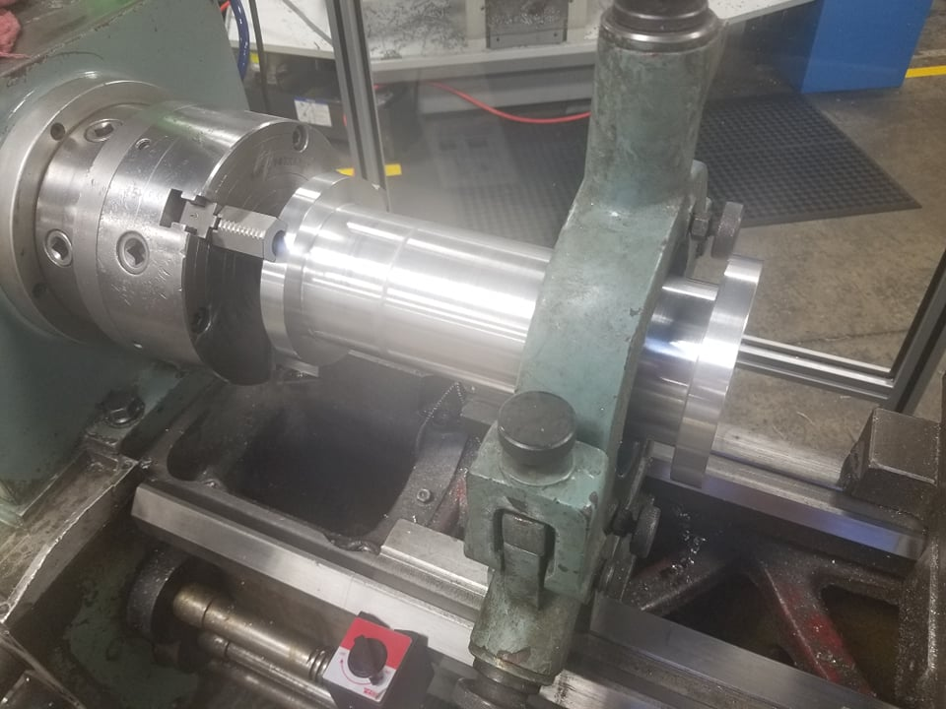
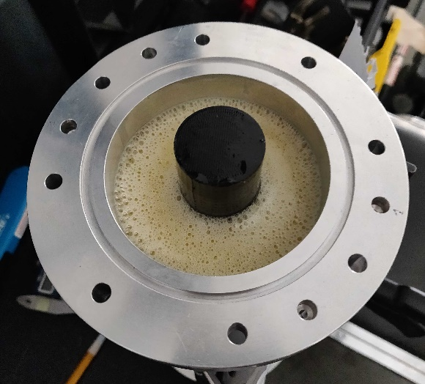
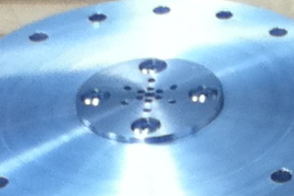
Year 2 – Manufacture
Assembly of the flow regulator
Combustion chamber chucked on the lathe machined by a machinist at TURBOCAM and myself
Runaway fully assembled with the aluminum chamber, injector and graphite nozzle
Machining and assembly of impinging plate
Molding the rubber into the combustion chamber
University of New Hampshire
Students for the Exploration and Development of Space

Slide 14
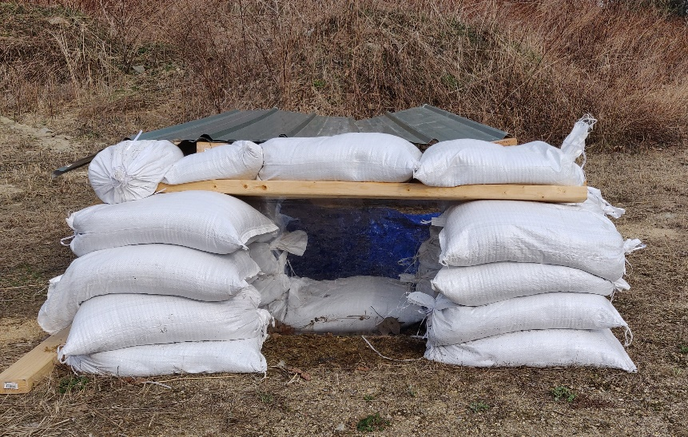
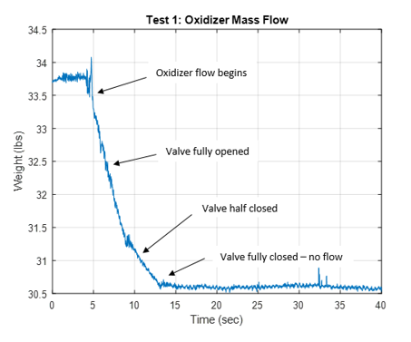
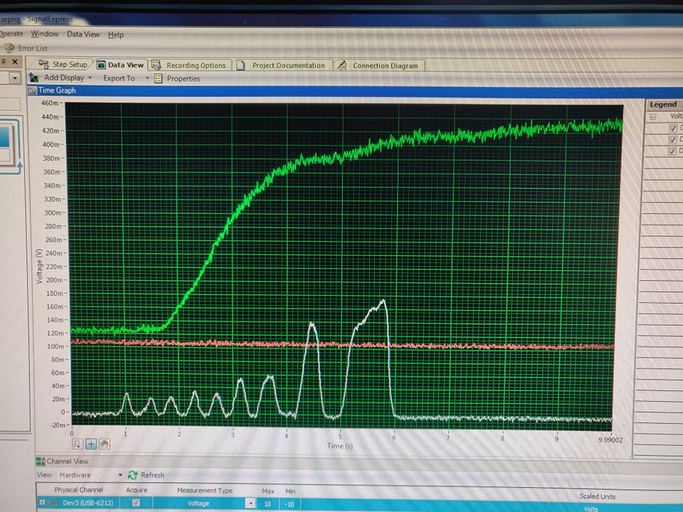
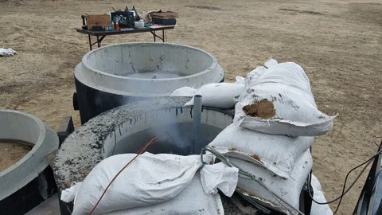
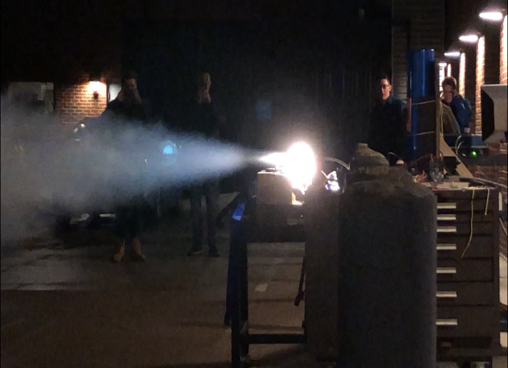
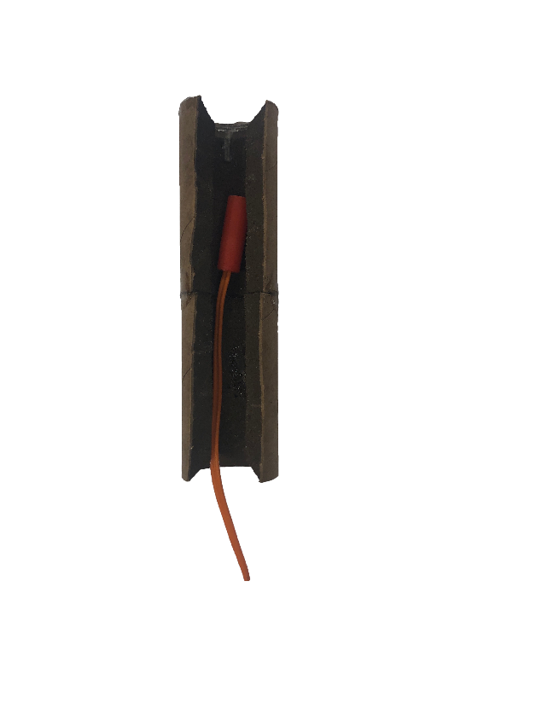
Year 2 – Test
Rapid impinging plate designs tested for impingement and desired flow rate
Electric spark and igniter assembly
Obtain thrust and temperature data during the hot-fire test
Control bunker for hot-fire tests
Hot-fire test 1 – Ignition
University of New Hampshire
Students for the Exploration and Development of Space

Slide 15

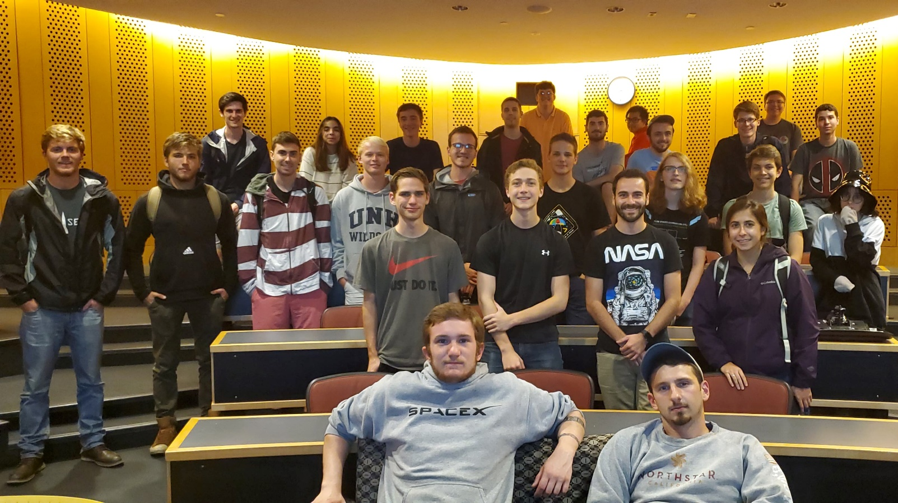
Rocket competition hosted in New Mexico from June 16th to June 20th
UNH SEDS will be competing in the 10,000-foot experimental hybrid engine category
Year 3 – Senior Year
Organization Statistics
Committed Members: 42 (+31)
Majors: 7 (+4)
Senior Projects: 14 (+10)
Funding: $9,000 and counting (+$6,750 so far)
My Role
President, Lead Engineer, Propulsion Lead
University of New Hampshire
Students for the Exploration and Development of Space

Slide 16
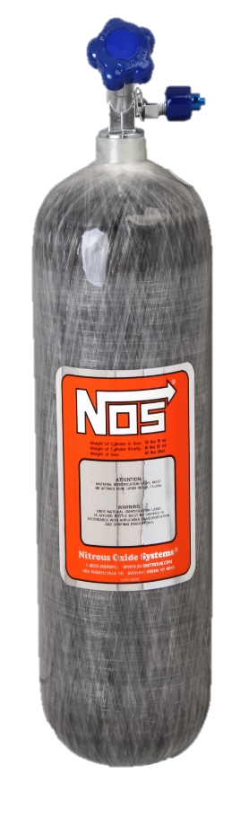
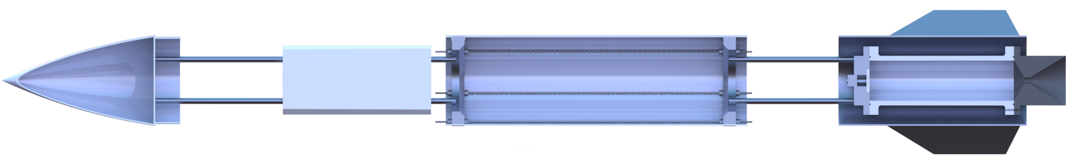

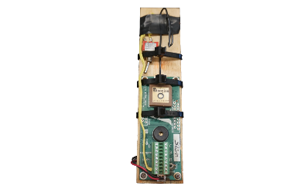

Year 3 – Rocket Vehicle
Avionics
An electronics module responsible for GPS tracking, engine ignition and flow control
Research Payload
A payload built in-house to collect data
Throttle Control
A flow regulation system to insert oxidizer flow into the chamber
Recovery System
A recovery module that is deployed at apogee
Oxidizer Storage
A pressurized vessel holding the liquid oxidizer
Runaway
New Hampshire’s first hybrid rocket engine that utilizes a liquid oxidizer and solid fuel
University of New Hampshire
Students for the Exploration and Development of Space

Slide 17


Year 3 – Engine Optimization
Future Engine Development
Obtain pressure data from hot fires
Pressure testing via hydrostat
Flow simulations to optimize nozzle and impinging plates
Reduce mass with dynamic sims
Stainless 304 selected for new nozzle
Provides a FOS of 3
Common material for temperature and corrosive resistance
Machined by a new sponsor
Hot-Fire Test 3 scheduled for October 10th by 5:00 pm EST
Cleaner electronic start sequence
Stainless nozzle
Hot-Fire Test 2 – August 2019
SPT25-20-1000A
0-1000 psi
12V DC operating voltage
Corrosion and heat resistant (SS sensor)
.15 seconds in, nozzle brittle failure from tension
Simulations underestimated pressure and designed to FOS 1.25 → bad decision
University of New Hampshire
Students for the Exploration and Development of Space

Slide 18




Year 3 – Project Management
$5,000 – BBQ for all
$9,000 - Chicken Suit day of conference
$15,000 - Dye Hair any color (2 weeks)
$25,000 - Tattoo on the behind
$30,000 - Dye and Tattoo
University of New Hampshire
Students for the Exploration and Development of Space

Slide 19

Takeaways and Moving Forward
Engineering
Building techniques, flight simulations → use for throttle control
Lead the development of New Hampshire’s first hybrid engine
Directing the entire hybrid rocket project for Spaceport
Didn’t push the importance of FEA/CFD
Moving Forward
Continue to iterate Runaway to be the propulsion module in the hybrid rocket
Manage all engineering leads
Frame, Avionics, Operations
Compete in Spaceport America Cup
Ensure successful knowledge transfer to underclassmen with defined future leaders
Organization and Project Management
Built a family of future aerospace engineers
Grew as a leader, understanding people have different imperatives to life
The importance of transparency to leadership
Now the most interdisciplinary engineering organization
Didn’t realize the importance of showing the success of the organization to the school/community
Presenting at a national space conference
University of New Hampshire
Students for the Exploration and Development of Space

